Slide 1
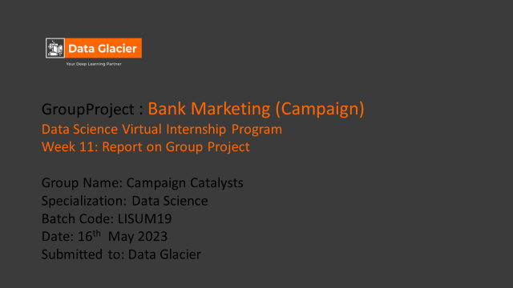

Slide 2
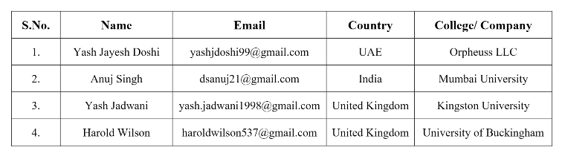
Team Members

Slide 3

Executive Summary
Business Understanding
Business Objective
Data understanding
Data Preparation
Data Model Building
Model Selection
Agenda

Slide 4
Executive Summary
The Client:
The data is related with direct marketing campaigns of a Portuguese banking institution. The marketing campaigns were based on phone calls. Often, more than one contact to the same client was required, in order to access if the product (bank term deposit) would be ('yes') or not ('no') subscribed
ABC Bank wants to sell it's term deposit product to customers and before launching the product they want to develop a model which help them in understanding whether a particular customer will buy their product or not (based on customer's past interaction with bank or other Financial Institution).

Slide 5
CRISPS-DM Methodology:
The cross-industry standard practice for data mining process has been extensively used to carry out most data analysis or mining project. The CRISP-DM data mining methodology published in 2000 which outline the steps the needs to be adhered to when performing a data mining process to achieve the outmost results.
Business Understanding
Data Understanding
Data Preparation
Data Modelling

Slide 6
Business Understanding
In this problem statement, the marketing strategy involves promoting the term deposit product to potential customers through various channels such as tele marketing, SMS, email marketing, etc. The aim of the marketing strategy is to reach out to a large number of customers and convince them to purchase the product.
However, it can be a costly and resource-intensive process to target every customer. Therefore, ABC Bank wants to develop a machine learning model that can help them identify the customers who are more likely to buy the product. This way, the marketing efforts can be focused on these shortlisted customers, which can significantly increase the chances of success while reducing marketing costs and resources
By leveraging the insights gained from the machine learning model, ABC Bank can optimize their marketing campaigns, tailor their marketing messages to specific customers, and improve their overall customer acquisition strategy. The bank can also use the model to identify the most effective marketing channels for each customer segment, such as email marketing for younger customers and tele marketing for older customers, for example

Slide 7
Business Objective:
Bank wants to use ML model to shortlist customer whose chances of buying the product is more so that their marketing channel (tele marketing, SMS/email marketing etc.) can focus only to those customers whose chances of buying the product is more.
Overall, the goal of the marketing strategy is to increase the customer base and revenue of ABC Bank by targeting the right customers with the right product at the right time, while maximizing the return on investment of their marketing efforts.

Slide 8
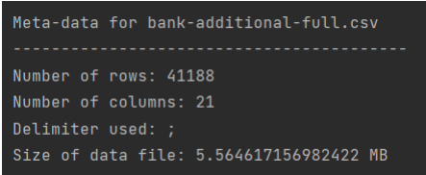
Data Understanding
The dataset chosen for further analysis and for ML model creation will be bank-additional-ull.csv because it seems to be ideal for the purpose of this project since it is more recent and has more variables, which helps us to build an efficient model.
In this stage the main objective includes cleaning the data, dealing with missing and unknown values, reducing data dimensionality, transforming data values, and sometimes reformatting the data to suite the desired mining solution. Other operations performed under this stage includes data aggregation, normalisation, and attribute creation i.e., making new variables to tackle specific business queries.

Slide 9

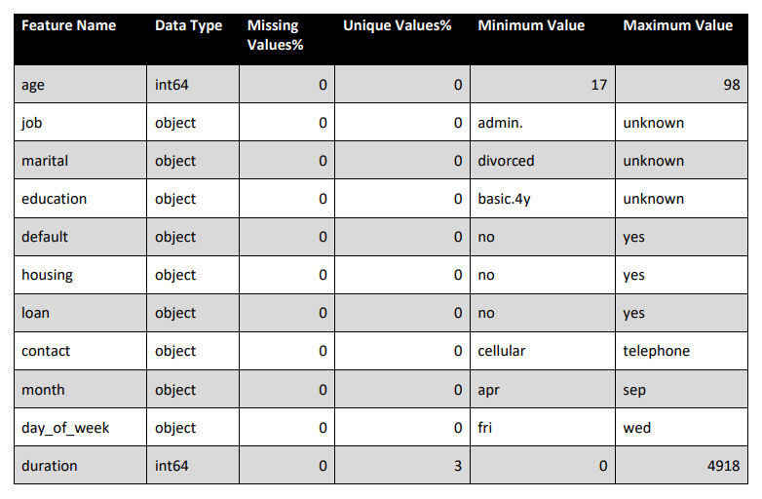
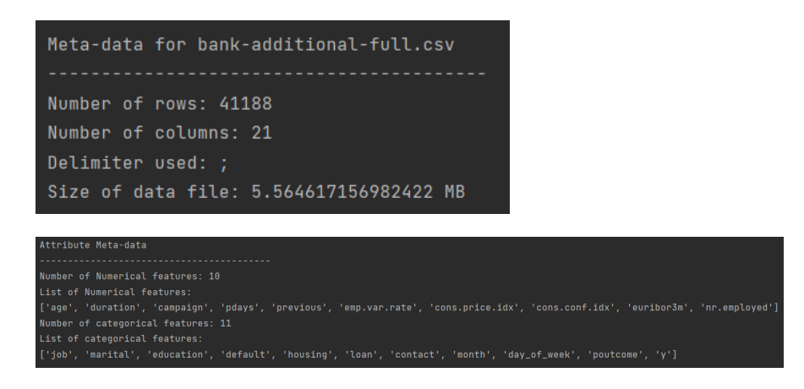
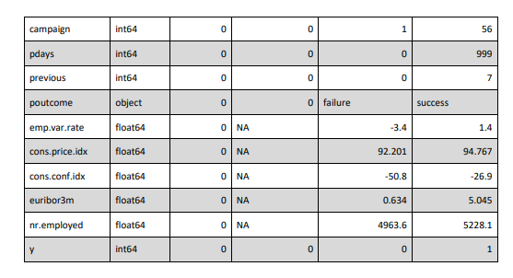
Below images display the meta-data of the data that we will be using along with the meta-data of it’s attributes.

Slide 10
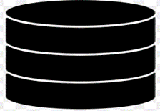
Data Preparation
Outliers removed from original data set
Cleaned Data:
bank-additional-full data set
Duplicates removed from the original data set
Missing values, unknown values dealt with and removed from the data set.

Slide 11

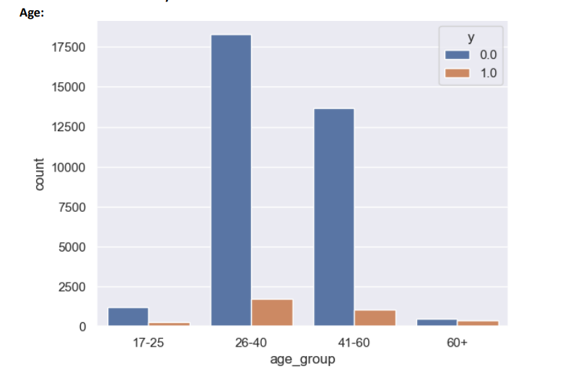
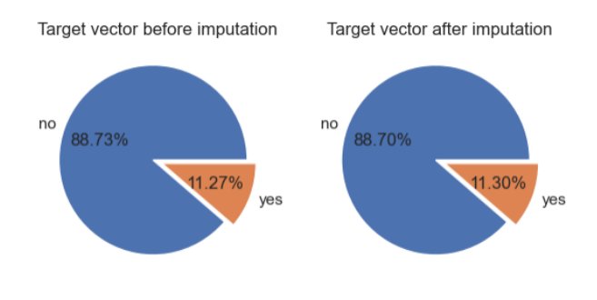
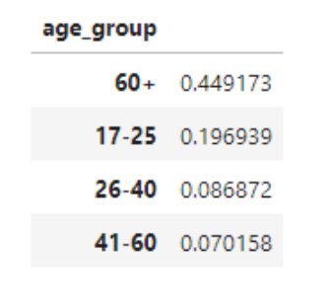
Target vector share before and after Imputation

Slide 12
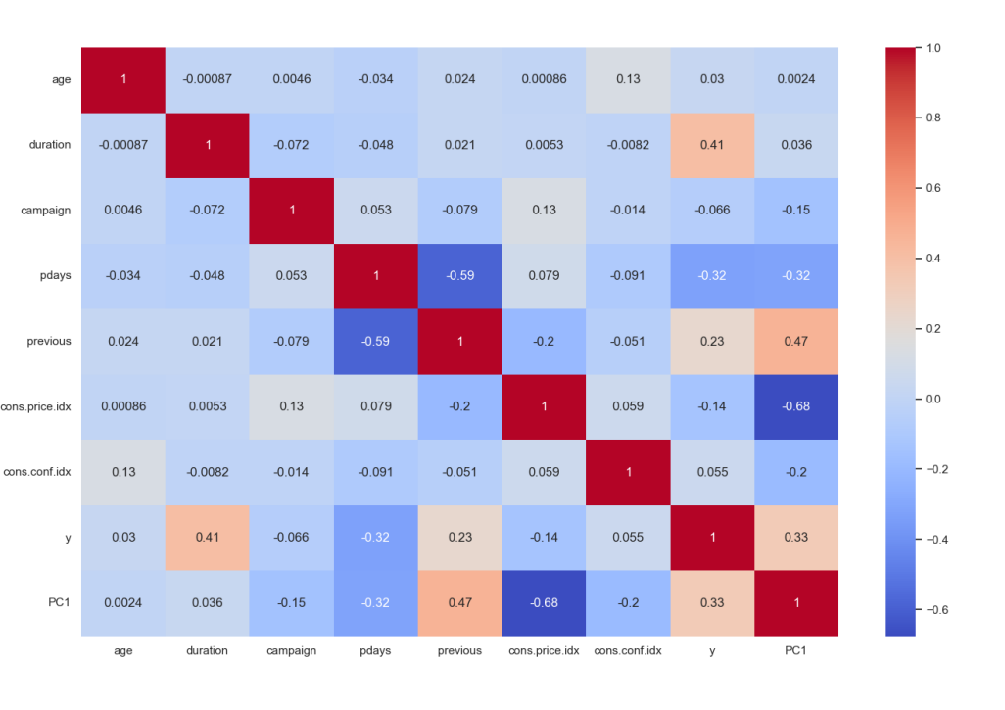
Correlation between features
Data Preparation-EDA of Features
After transforming the three highly correlated features into one feature using PCA, the below image shows the heatmap of the Pearson’s Correlation matrix of the updated dataframe. It is evident from the similar correlation value between the new feature PC1 and y that the correlation problem has been solved without losing the information contained in the features

Slide 13
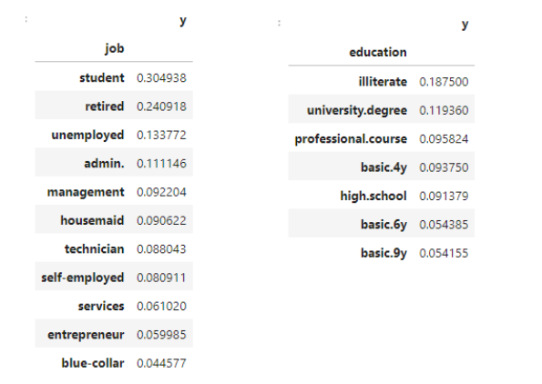
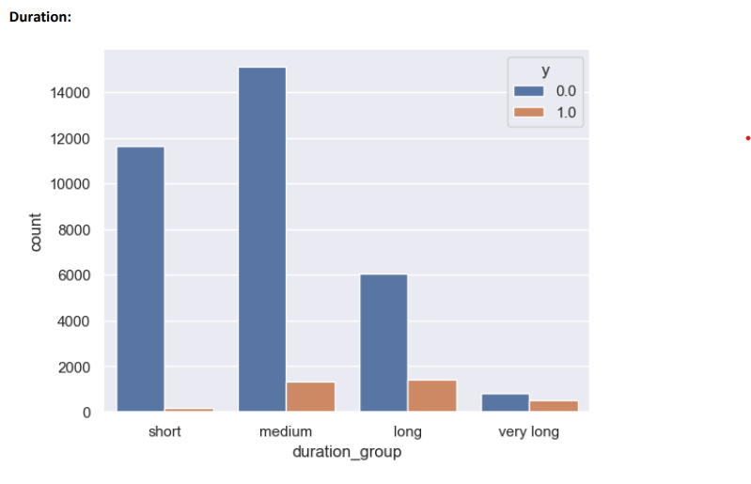
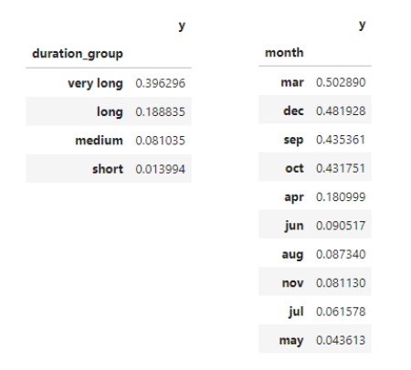
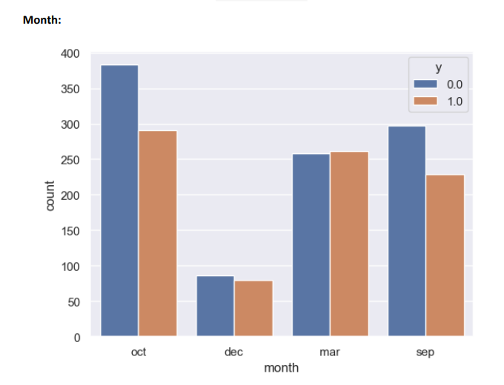
Data Preparation-EDA of Numerical Features
March had the most conversions for the bank's term deposit product despite only around 500 calls. The success may have been influenced by factors like interest rates, promotions, and sales representatives.

Slide 14
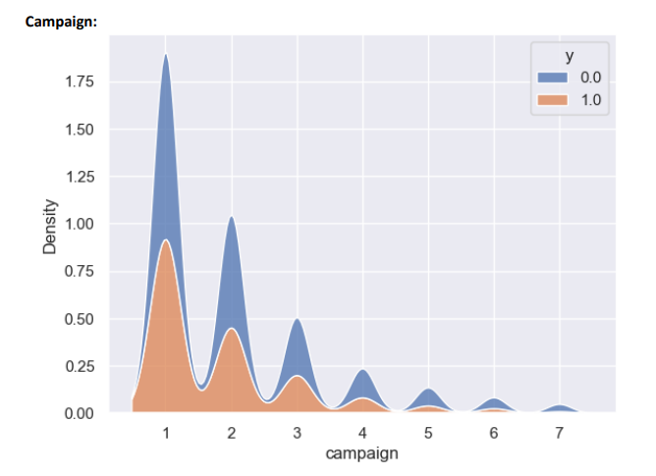
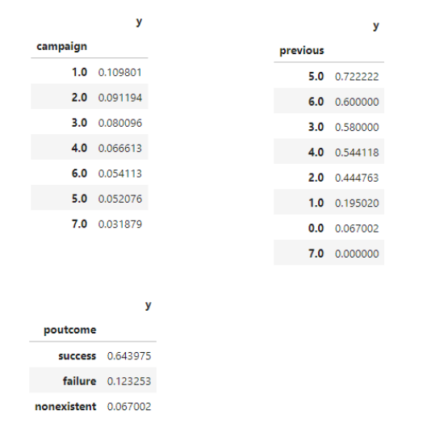
Data Preparation-EDA of Numerical Features

Slide 15
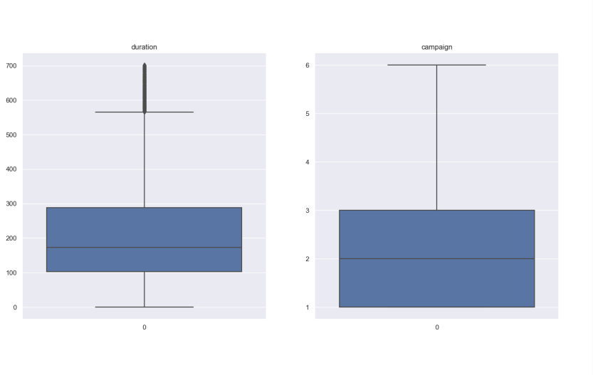
Analysis of Outliners
Data Preparation-EDA of Numerical Features
The boxplots reveal that majority of the outliers were successfully remove
For the ‘pdays’ column, it was found that the outliers were due to 999 values, which were placeholders for missing data. Since more than 95% of the values are 999, we will drop the ‘pdays’ column entirely

Slide 16
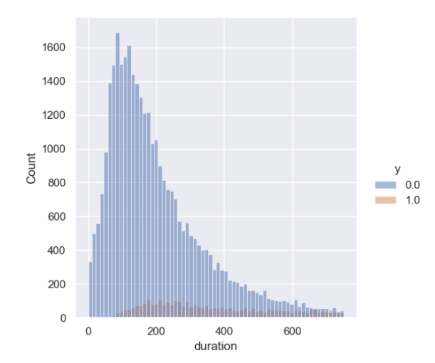
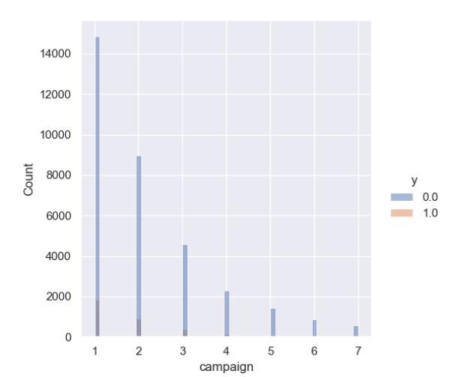
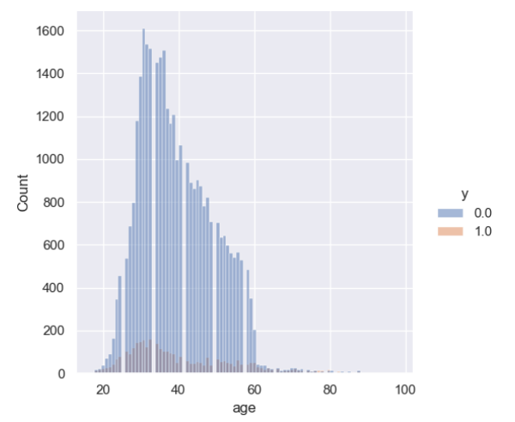
Visualizing distributions for each category of target variable:
Data Preparation-EDA of Categorical Features
Observations 1:
Age: Most of the calls were made to people aged 25-50.
Percentage of subscriptions seems to be approximately constant across all ages.
Duration: As expected, percentage of subscriptions increases with the increase in call duration.
Campaign: There seems to be almost no subscriptions for more than 4 contacts in the current campaign

Slide 17
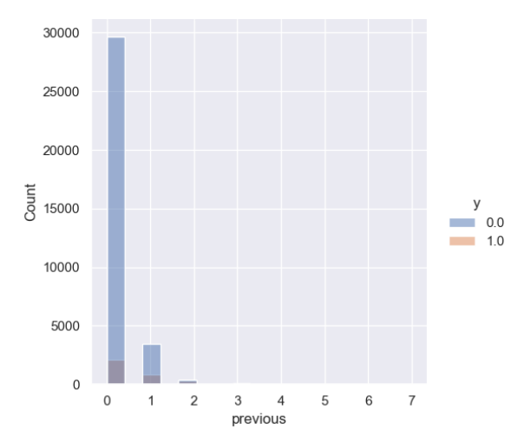
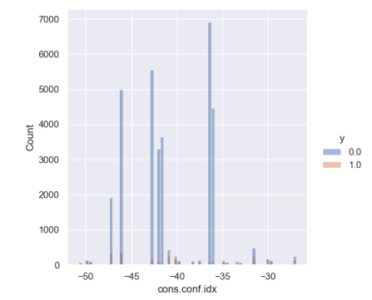
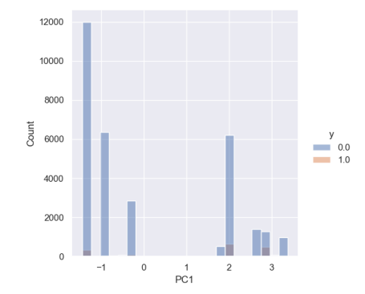
Data Preparation-EDA of Categorical Features
Previous: Data is heavily skewed to number of contacts = 1. Percentage of conversion seems to be consistent with overall value.
cons.price.idx, cons.conf.index and PC1:
There seems to be some correlation with target variable. But the trend is not clear, this may be clearer when coupled with month and year values.

Slide 18
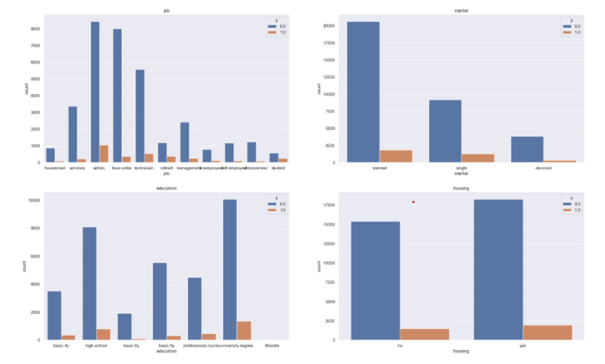
Visualizing distributions for each category of target variable:
Data Preparation-EDA of Categorical Features
job: 'admin','blue-collar' and 'technician' jobs were contacted most. 'Retired' and 'Student' categories gave the highest percentage of subscriptions
• marital: most of the people contacted were married. The percentage of subscriptions didn't seem to change much with marital status •
education: most of the people contacted had either 'university. degree' or 'high. school' as their highest level of education. Though, 'illiterate' customers gave the highest percentage of subscriptions
housing: There is no imbalance observed with respect to housing. The percentage of subscription also seems to be constant.

Slide 19
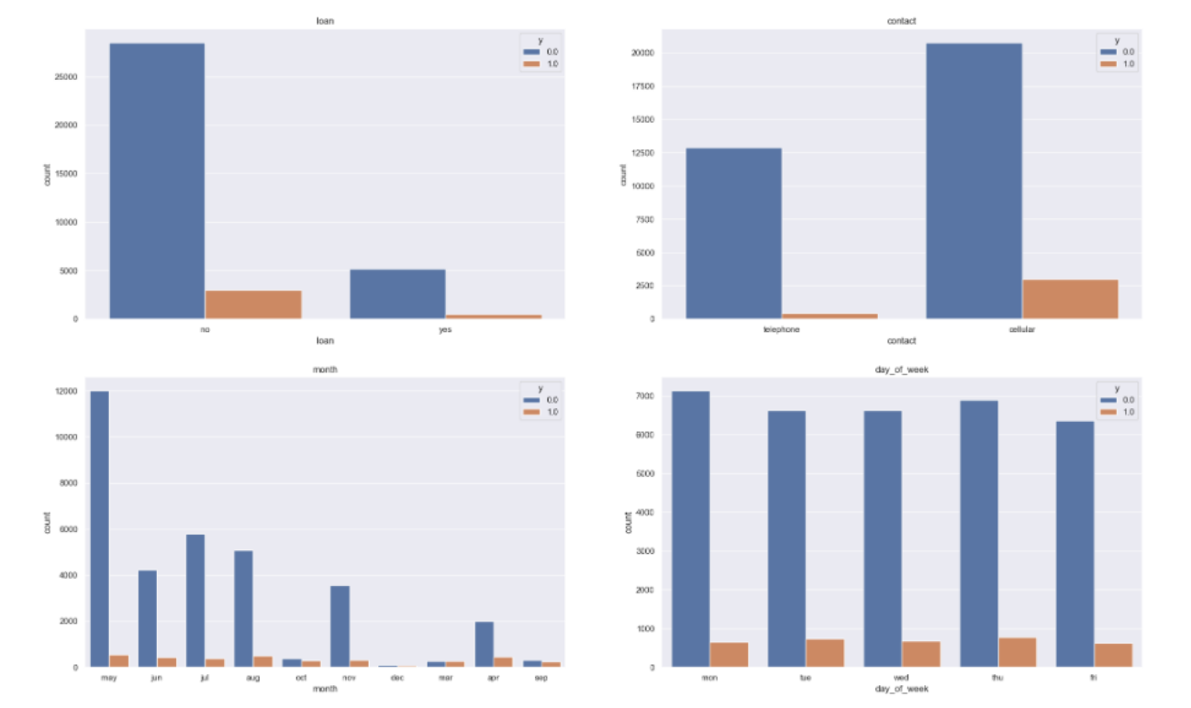
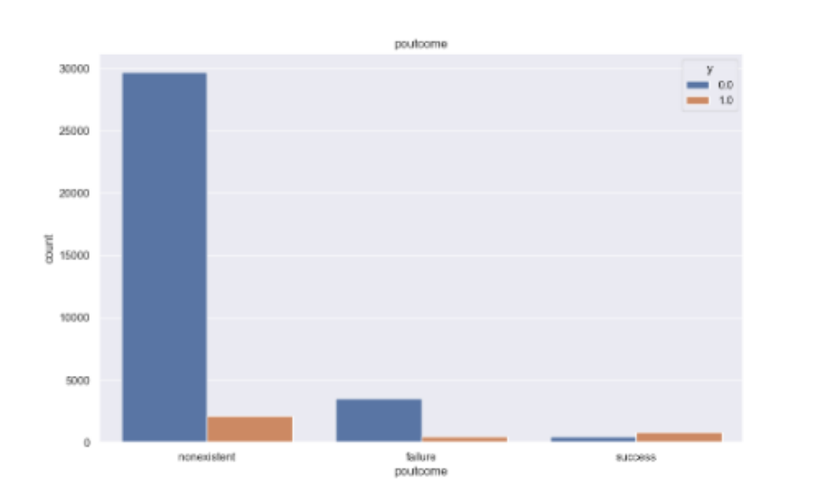
Data Preparation-EDA of Categorical Features
Loan: Most of the people contacted didn't have a personal loan. People without personal loan did seem to be more likely to subscribe but the difference between the two categories is small.
Contact: most of the people were contacted through a cellphone. This did result in a significantly higher percentage of subscriptions.
Month: Most of the contacts were made in the second quarter. Some months gave a significantly higher percentage of subscriptions than other months, but the trend is not very clear and there may be other factors at play here.
day_of_week: Number of contacts and percentage of subscriptions doesn't seem to change much with day of the week.
Outcome: The outcome of previous campaigns was "nonexistent" for most of the contacts. Although, the success of previous campaigns did seem to positively impact the subscriptions of current campaign

Slide 20
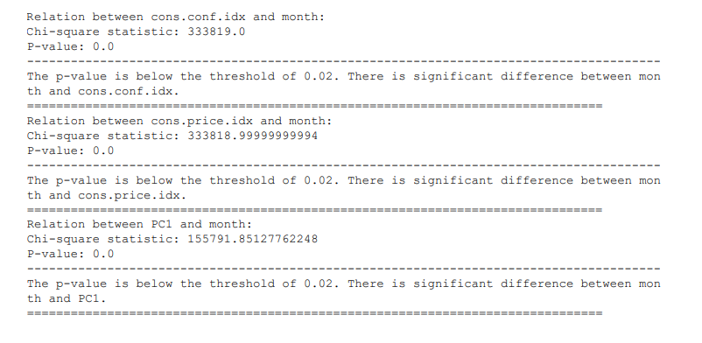
Hypothesis testing: Testing correlation between month and economical indicators:

Slide 21
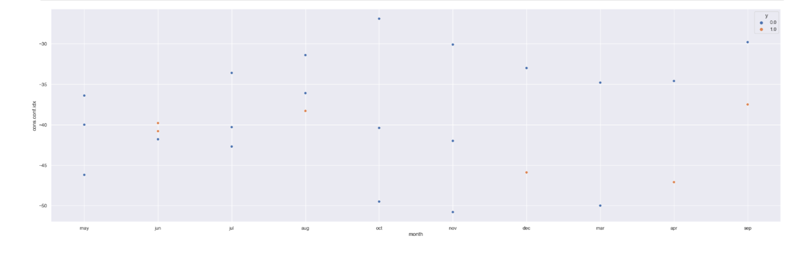
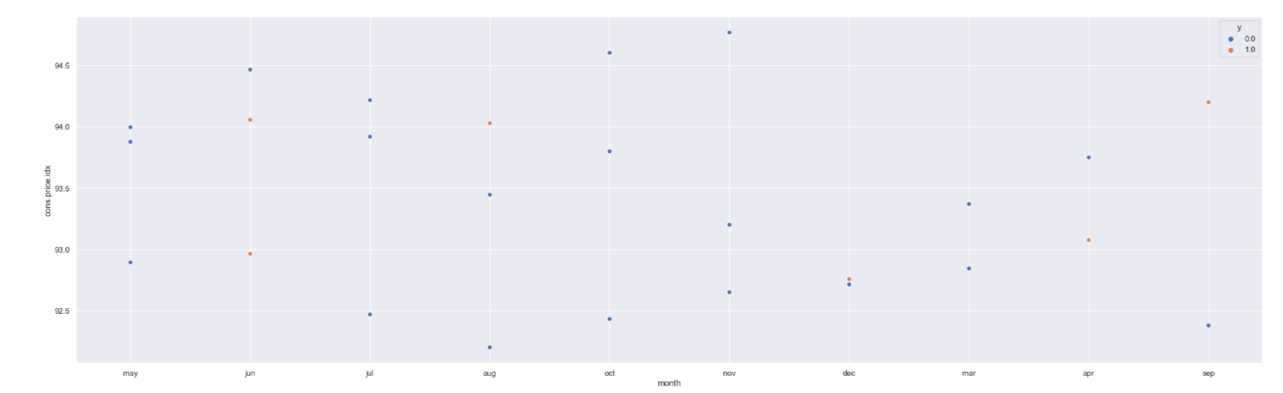
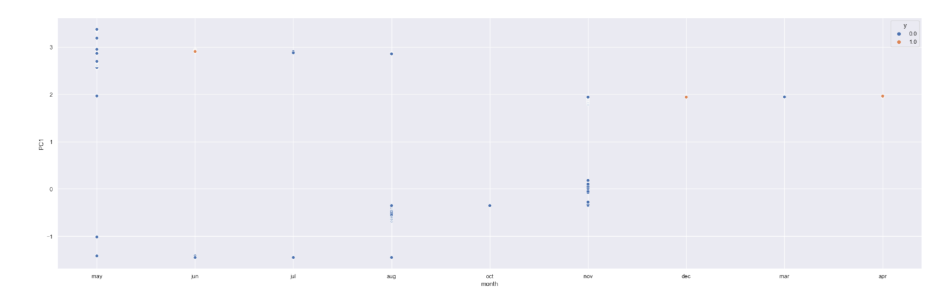

Slide 22
Data Modelling
Model Evaluation plays a crucial role in the model development process, where it helps to find the best model that fit and represents the data set in question. These models are assessed based on their performance.
Data mining is an iterative process; hence the generated modelling results should be evaluated against the business objectives, and sometimes should the accuracy of the mining model be poor, the whole mining process needs to be revisited starting from the business point and understanding of the data.
We will be using a set of evaluation metrics to assist in the process of accessing the performance of these classifiers.
Accuracy
Precision
F1 Score
Lift and Gain
KS Statistics
AUC-ROC

Slide 23
Recommended Models
We have 8 categorical Variables and 7 numeric variables in the data after cleaning the data in week 10. We can make these models in the upcoming weeks:
Logistic regression: Logistic regression is a simple but effective model for binary classification problems. It is easy to interpret and can be used to understand the relationship between the features and the target variable.
It is a simple and easy-to-understand model.
It is relatively fast to train.
Random forest: Random forest is a more complex model that can be used for both classification and regression problems. It is an ensemble model that combines multiple decision trees to improve the accuracy of the predictions. Random forests are also relatively easy to interpret and can be used to understand the relationship between the features and the target variable.
It is a powerful model that can achieve high accuracy.
It is relatively robust to overfitting.
Decision tree: Decision trees are a simple but effective model for classification problems. They can be used to predict the target variable by creating a decision tree that branches out based on the features. Decision trees are also relatively easy to interpret.
It is a simple and easy-to-understand model.
It can be used for both classification and regression problems.
It can be used to identify important features.
XGBoost: XGBoost is a powerful gradient-boosting algorithm that can be used for both classification and regression problems. It is known for its accuracy and speed. XGBoost can be difficult to interpret, but it can be used to understand the relationship between the features and the target variable by looking at the feature importance scores.
It is a powerful model that can achieve high accuracy.
It is relatively robust to overfitting.

Slide 24
Recommended Models
We have 8 categorical Variables and 7 numeric variables in the data after cleaning the data in week 10. We can make these models in the upcoming weeks:
KNN: KNN is a non-parametric model that can be used for both classification and regression problems. It works by finding the K most similar data points to a new data point and then predicting the label of the new data point based on the labels of the K nearest neighbours. KNN is relatively simple to implement and can be used to understand the relationship between the features and the target variable by looking at the K nearest neighbours of a new data point.
It is a simple and easy-to-understand model.
It is relatively fast to train.
Gradient boosting: Gradient boosting is an ensemble learning method that can be used for both classification and regression problems. It works by iteratively adding new models to correct the errors made by previous models. Gradient boosting can be difficult to interpret, but it can be used to understand the relationship between the features and the target variable by looking at the feature importance scores.
It is a powerful model that can achieve high accuracy.
It is relatively robust to overfitting.
Voting classifiers: Voting classifiers are a type of ensemble learning method that combines the predictions of multiple models to make a final prediction. Voting classifiers can be used to improve the accuracy of the predictions by reducing the variance of the individual models. Voting classifiers can be hard or soft. Hard-voting classifiers make a single prediction for each data point while soft-voting classifiers assign a probability to each class for each data point.
They can improve the accuracy of predictions by combining the predictions of multiple models.
They can be used to reduce the variance of predictions.
They can be used to improve the robustness of predictions to overfitting.

Slide 25
Thank You

